Slide 1
Team Work Assignment OOP Programming Role – Playing Game Team “ Grasshoper ”
Participants:
Нина Петкова – nina75
Пламен Пенчев – Burned
Динко Кръстев – DinkoK
Александър Николов – redOne
Антонио Маринов – Nottyy
Антоний Зюмбюлев – antonious7
Васил Профиров – V.Profirov
Явор Михалйлов – phreak
Николай Георгиев – niki.georgiev
Петко Попов – PetkoP
Петър Ненов – pepoto

Slide 2
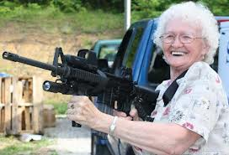
Briefly summary about the game:
Resume:
One rainy afternoon, our grandmother has finally decided to bring order in the tense situation in Sofia and put an end the state iniquities and outrages, as walking in front of the Parliament and with bare hands starting to strike at police officers and deputies with whatever she carries in her bag and with herself. She even got far more well prepared because early before she came across “the battlefield”, she found a gun in an abandoned building next to her apartment in Reduta.
Main character: The Granny
Secondary characters:
Policemen, Politicians
BGmom, Walkers

Slide 3
Grandmother’s attributes and Scenario
Assets:
Bag, Cane, Umbrella, Gun
Scenario:
The grandmother firstly has only cane, umbrella, bag and gun, as she doesn’t have any money.
If she kills a politician or a policeman she gains 100$.
She could visit BGmom for guns, if she has money
If she goes through a politician or a policeman, without killing it, she loses a precise part of her equipment. After losing all the available equipment she starts losing her health.
The game ends when she loses all her equipment and health.

Slide 4
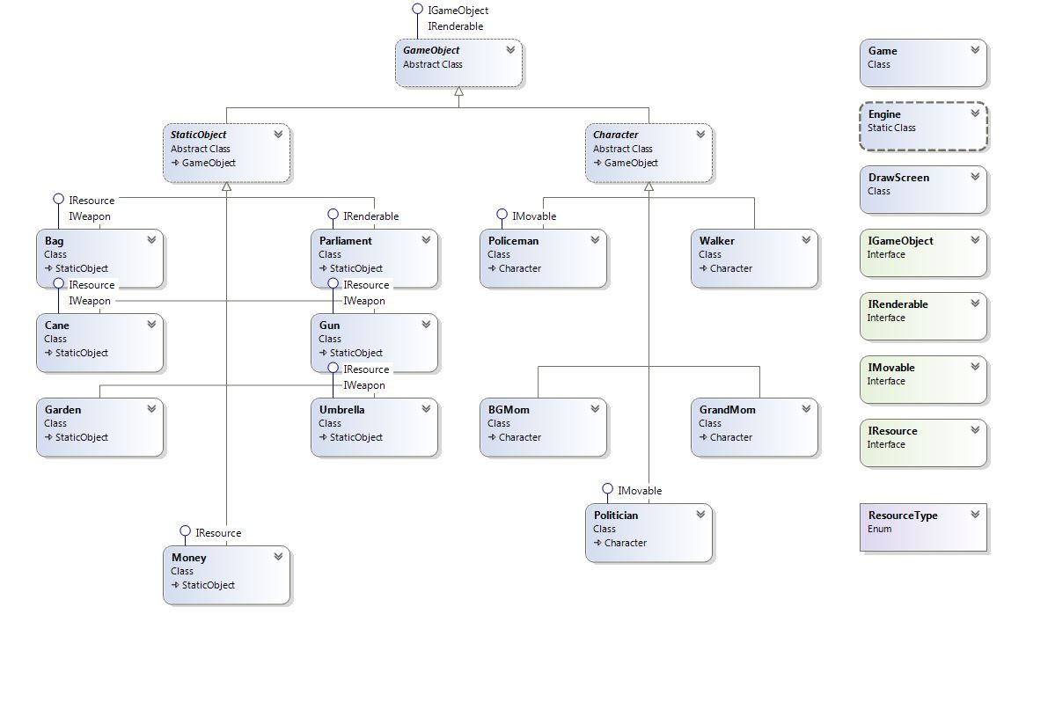
Class Diagram

Slide 5
Thank you for your patience ☺ see you in next episode

